Slide 1
Integrating security into modern software development: A workflow study
Lucas Charles
Secure Software Engineer @ GitLab
about.gitlab.com
Notes:
Good morning! Thanks for coming, everyone.
* How security has evolved to where it is
* Rise of shift-left efforts
* Minimum viability wreaks havoc
Mantra: Security is hard
Not streamlining security tools but aligning workflows.
new ways of thinking about appsec
apply modern ideas like collaboration && easier lives
If you have any questions, feel free to raise them throughout or just save them for the end

Slide 2
Who am I
Lucas Charles (@theoretick on the interwebs)
Software Engineer @ GitLab, focused on Security Products
Consultant for several Fortune 500 companies, focused on testability and Continuous Deployment
Notes:
So, before we dig in, just a bit of info about who I am
For those unfamiliar, GitLab is a single application for the entire DevSecOps lifecycle.
This means that we aim to solve many of the issues under discussion today: integration, enablement, and collaboration.
Consultant:
building modern software && teaching how to build it themselves.
traditional ways of doing things, buzzword bingo, when processes no longer scale.
where the tooling meet the workflows.

Slide 3
What I care about
Tooling
Notes:
So, in my roles I've gotten to play with a lot of tools.
<3 tools.
Our tools are what let us do our jobs well and speed along the software development process.

Slide 4
What I care about
Tooling
Collaboration
Notes:
The other thing I really care about is Collaboration.
What good tools enable: google docs, webex, confluence, issue boards
all make collaboration seamless.
Where tools enable workflows
Key aspect of modern software

Slide 5
What I care about
Tooling
Collaboration
Transparency
Notes:
Finally, I care about Transparency.
Other side of the Collaboration coin
Making workflows clear to collaborators and outsiders.
NOT “Security through obscurity”
modern software and open-source
afer, less buggy, and more secure software.
No need to post all of your company's code on GitLab or GitHub
your workflow should keep your team members informed
what's been built
how it's staying secure.

Slide 6
Why I care about these things
Results!
Happiness! ᕕ( ᐛ )ᕗ
Notes:
Why do I care?
Not only results but happy results.

Slide 7
The Problem: A landscape overview
Notes:
Why this is hard?

Slide 8
Problem: Modern Software vs Legacy App Sec
Building modern software is hard
DevOps/Agile and iterative/MVP
Zero Trust as perimeters fade and apps become portable
“Shift Left” security and the desire to scale software sec
Notes:
So, what's the problem? Building modern software is hard. (++ doing so securely)
Traditional appsec tools 10+ yrs
Tricky to match to today's methodologies (DevOps, agile development, and daily deployments)
Fundamentally incompatible.
This has led to the "Shift Left" movement.
The testing mantra goes "test early and test often"
early bug detection within dev leads to profoundly cheaper and safer software.
Applies equally well to security
consequences of a security vulnerability reaching a later stage in the pipeline can be dire.
So where has "Shift Left" gotten us?
It’s been great! Test more frequently, catch more issues, write better code.
Very effective in modern software testing, BUT sec traction
Everyone wants to shift left, it's cheaper but also harder. It also just isn't enough. Why is it not enough? Let’s dive in a bit more.

Slide 9
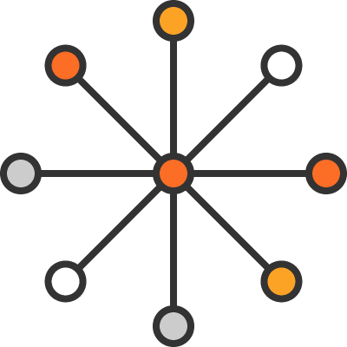
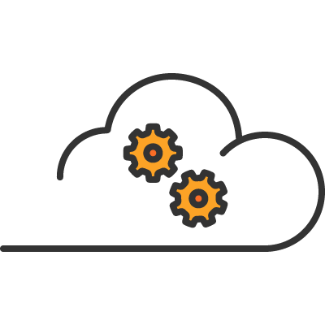
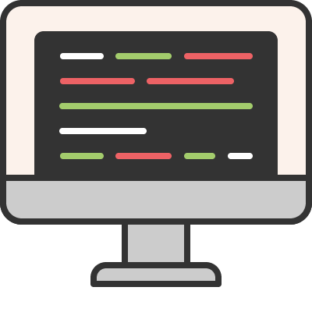
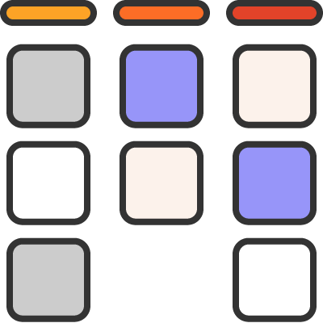
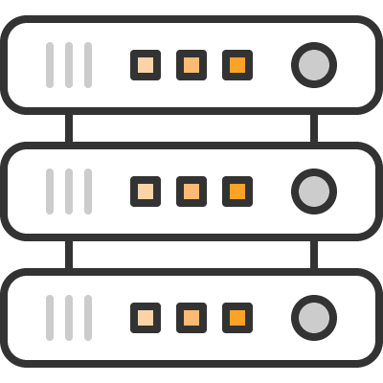
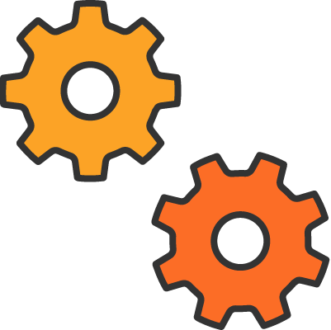
Problem: Cloud requires shared security accountability
Application Threat Detection
Application Access
App Configuration and
App Patching
APPS
Virtualization and root access
System Threat Detection
System Patching and
System Access
HOSTS
Network segmentation and Perimeter security
Network Threat Detection
NETWORKS
Cloud Configuration
FOUNDATION SERVICES
COMPUTE
STORAGE
DATABASE
NETWORK
Responsibility:
Cloud Provider
Security Vendors
End-user
Notes:
To illustrate let's look at how modern software is built.
Traditional app stack - appsec vs netsec, who owns what?

Slide 10
Problem: Cloud Native requires greater accountability
Orchestration (K8s): access/authentication, runtime resources, network policies
Containers: Images, Registry, East/West traffic
Application Threat Detection
Application Access
App Configuration and
App Patching
APPS
Virtualization and root access
System Threat Detection
System Patching and
System Access
HOSTS
Network segmentation and Perimeter security
Network Threat Detection
NETWORKS
Cloud Configuration
FOUNDATION SERVICES
COMPUTE
STORAGE
DATABASE
NETWORK
Responsibility:
Cloud Provider
Security Vendors
End-user
Notes:
Cloud Native attack vectors && blur landscape
Requiring technological familiarity
Containers & Kubernetes app portability
Containers are supposed to disconnect software from hardware (run it anywhere)
but now you have to figure out how to protect something as it moves around. So network security is useless.
- multi-cloud
Where does netsec fit in?
Traditional && container/image layer
For instance, an HR system should probably not be communicating with a point of sale app.
There are tools within the orchestrators that can help with security - things like setting policies for how long a process should run or maximum resources they should consume
complexity is building
New settings from Cloud providers to learn
More security capabilities themselves.
New releases
Time and experience have proven that people are generally not good at staying current with their patches.
Need guidelines but also automation
abstract the complexity.
Further, Microservices integrate with both internal parties and external ones, blurring the lines between what's deployed and where.

Slide 11
Problem: Modern Software vs Legacy App Sec
Reality is:
Applications are a prime target of cyber attacks
Code changes faster and faster, we need to test it iteratively
App Sec tools are expensive and require integration of both technology and processes
Notes:
We aren’t trying to catch up to traditional app sec.
<READ>
Get beyond simple shift-left
Add another sec scan earlier, DEV gets a lite static analysis tools in their IDE
Security must be baked into the SDLC and be purpose-built for the modern software factory.

Slide 12
Problem: Rapid Iteration
Iterative development is incongruent with “test everything” security flows
Notes:
Traditional "test everything flow” != minimum viable
Scan earlier? NO. Requiring earlier security scans isn't enough. App sec must be baked into the process.
Scaling security (because teams scale) means empowering developers
Not a new idea: Checkmarx
a great job of targeting devs and providing an integrated API
BUT it's limited in integration (you need Jenkins to kickoff the scans
Also relies on a sophisticated hashing routine to recognize changes, but it's a guess, not truly incremental.
Difficult without being a part of the code review process

Slide 13
Collaboration: Security and developer teams still fail to communicate
Security and developer teams still fail to communicate
Notes:
There are some trends here but the most important is around Collaboration
FAIL TO COMMUNICATE
Both roles are kept distinct and not being catered to.
Must shift not only WHERE scans, but WHO
Because security quickly becomes a blocker.
Devs don't want to be sec people
Need complimentary
First step: Enabling developers to take an active role in the security process (more later)

Slide 14
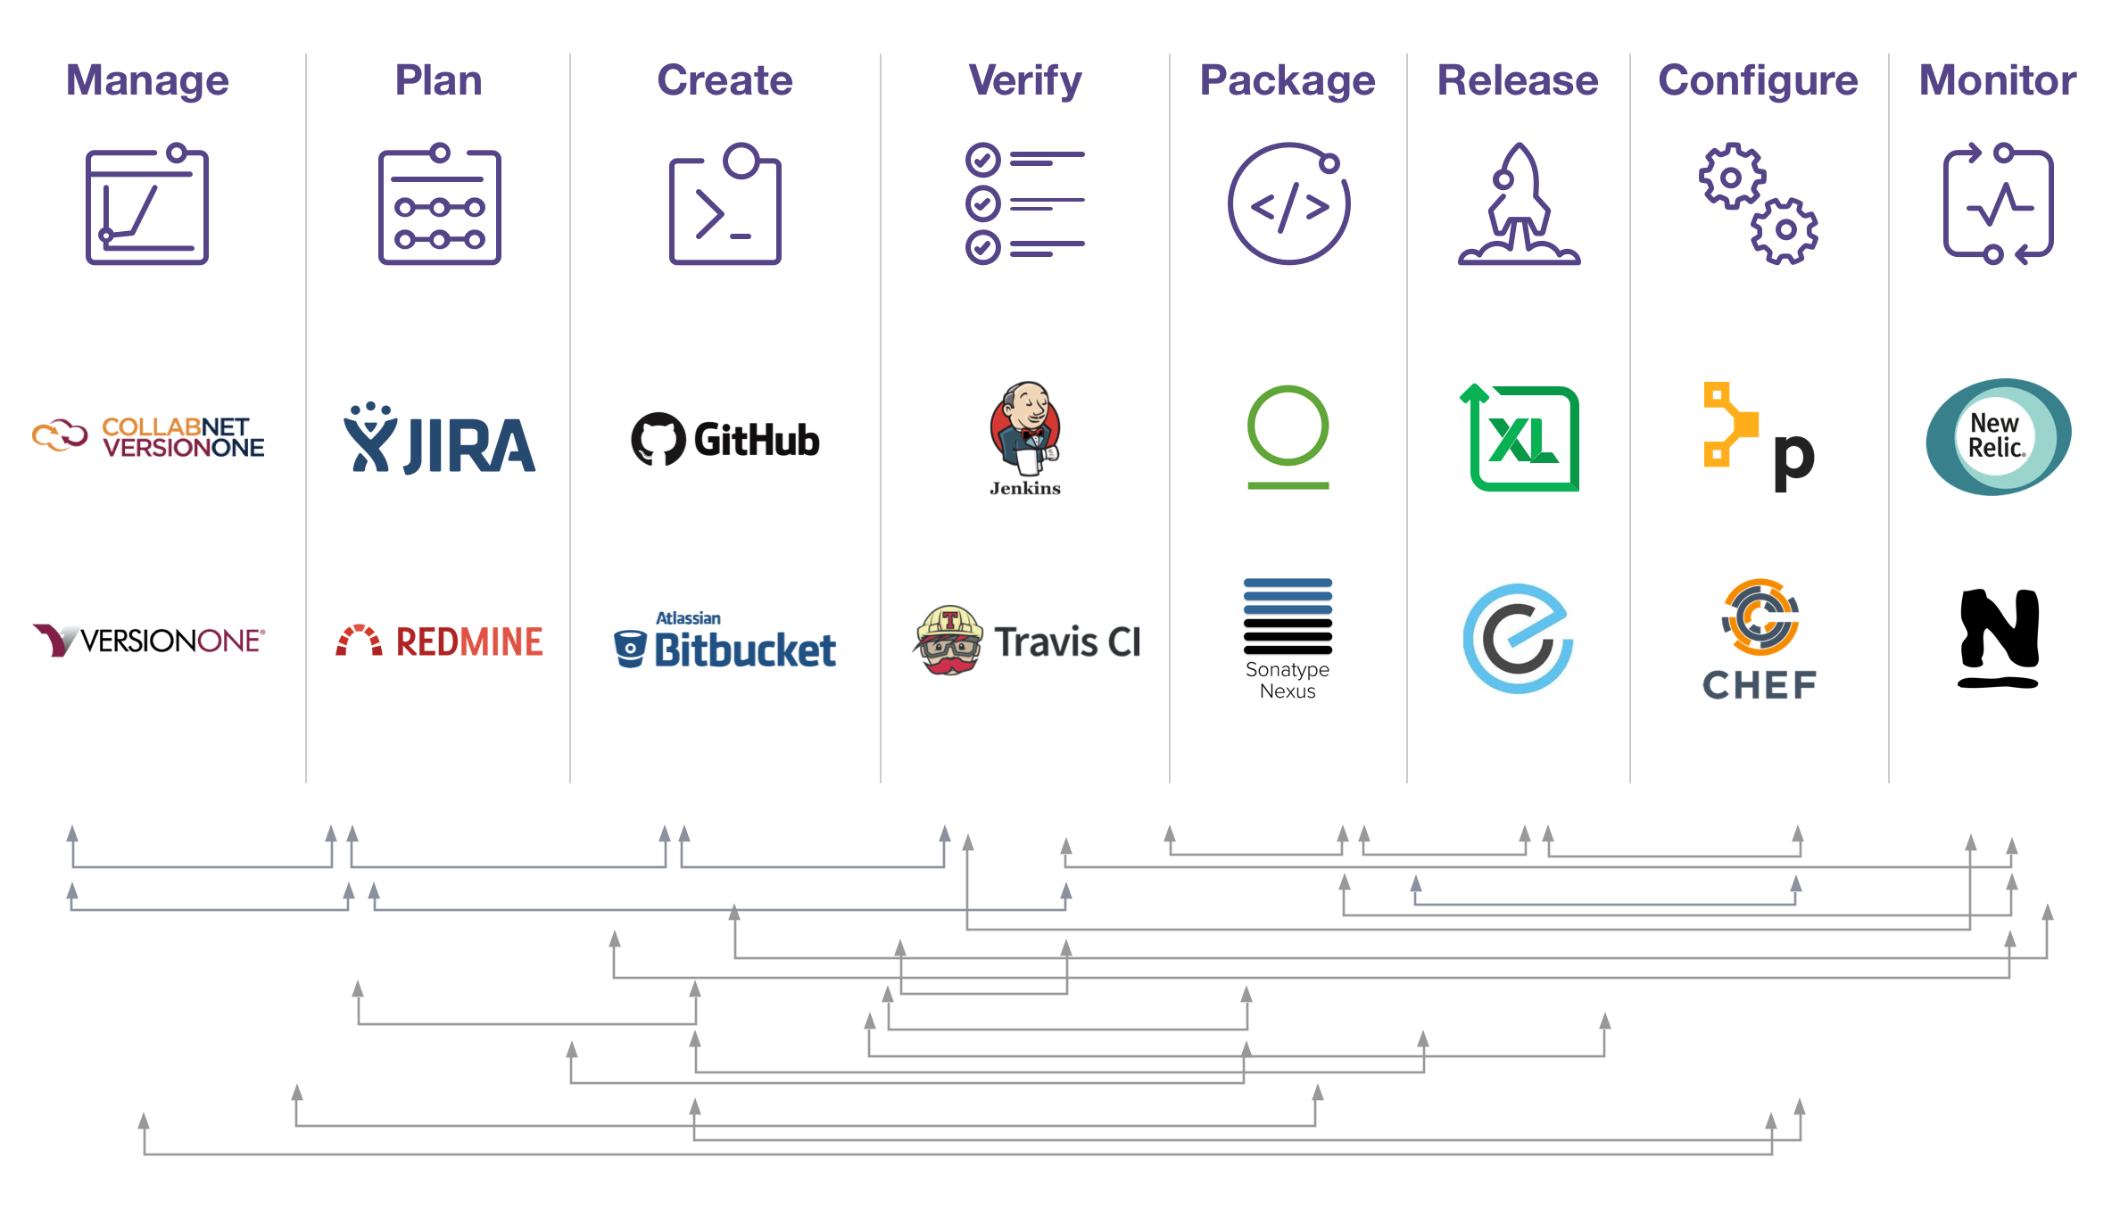
Integration: Complex Toolchains Reinforce Silos
https://about.gitlab.com/sdlc/#interfaces
Notes:
Modern Dev is hard: The difficulty is in connecting each of these steps.
Software people love tools
integrating is a difficult one.
Each stage is a different tool
doing one-thing-well
Users must develop workflow w/ context shifts and edges b/w stages
Complex toolchains eat resources and slow down the SDLC.
Reinforce silos that you are trying to break down in the name of DevOps.
Teams MUST be able to collaborate together, their different tools put them in different workspaces.
Both mental workspaces and physical ones
<talk through slides, what are we looking at?>

Slide 15
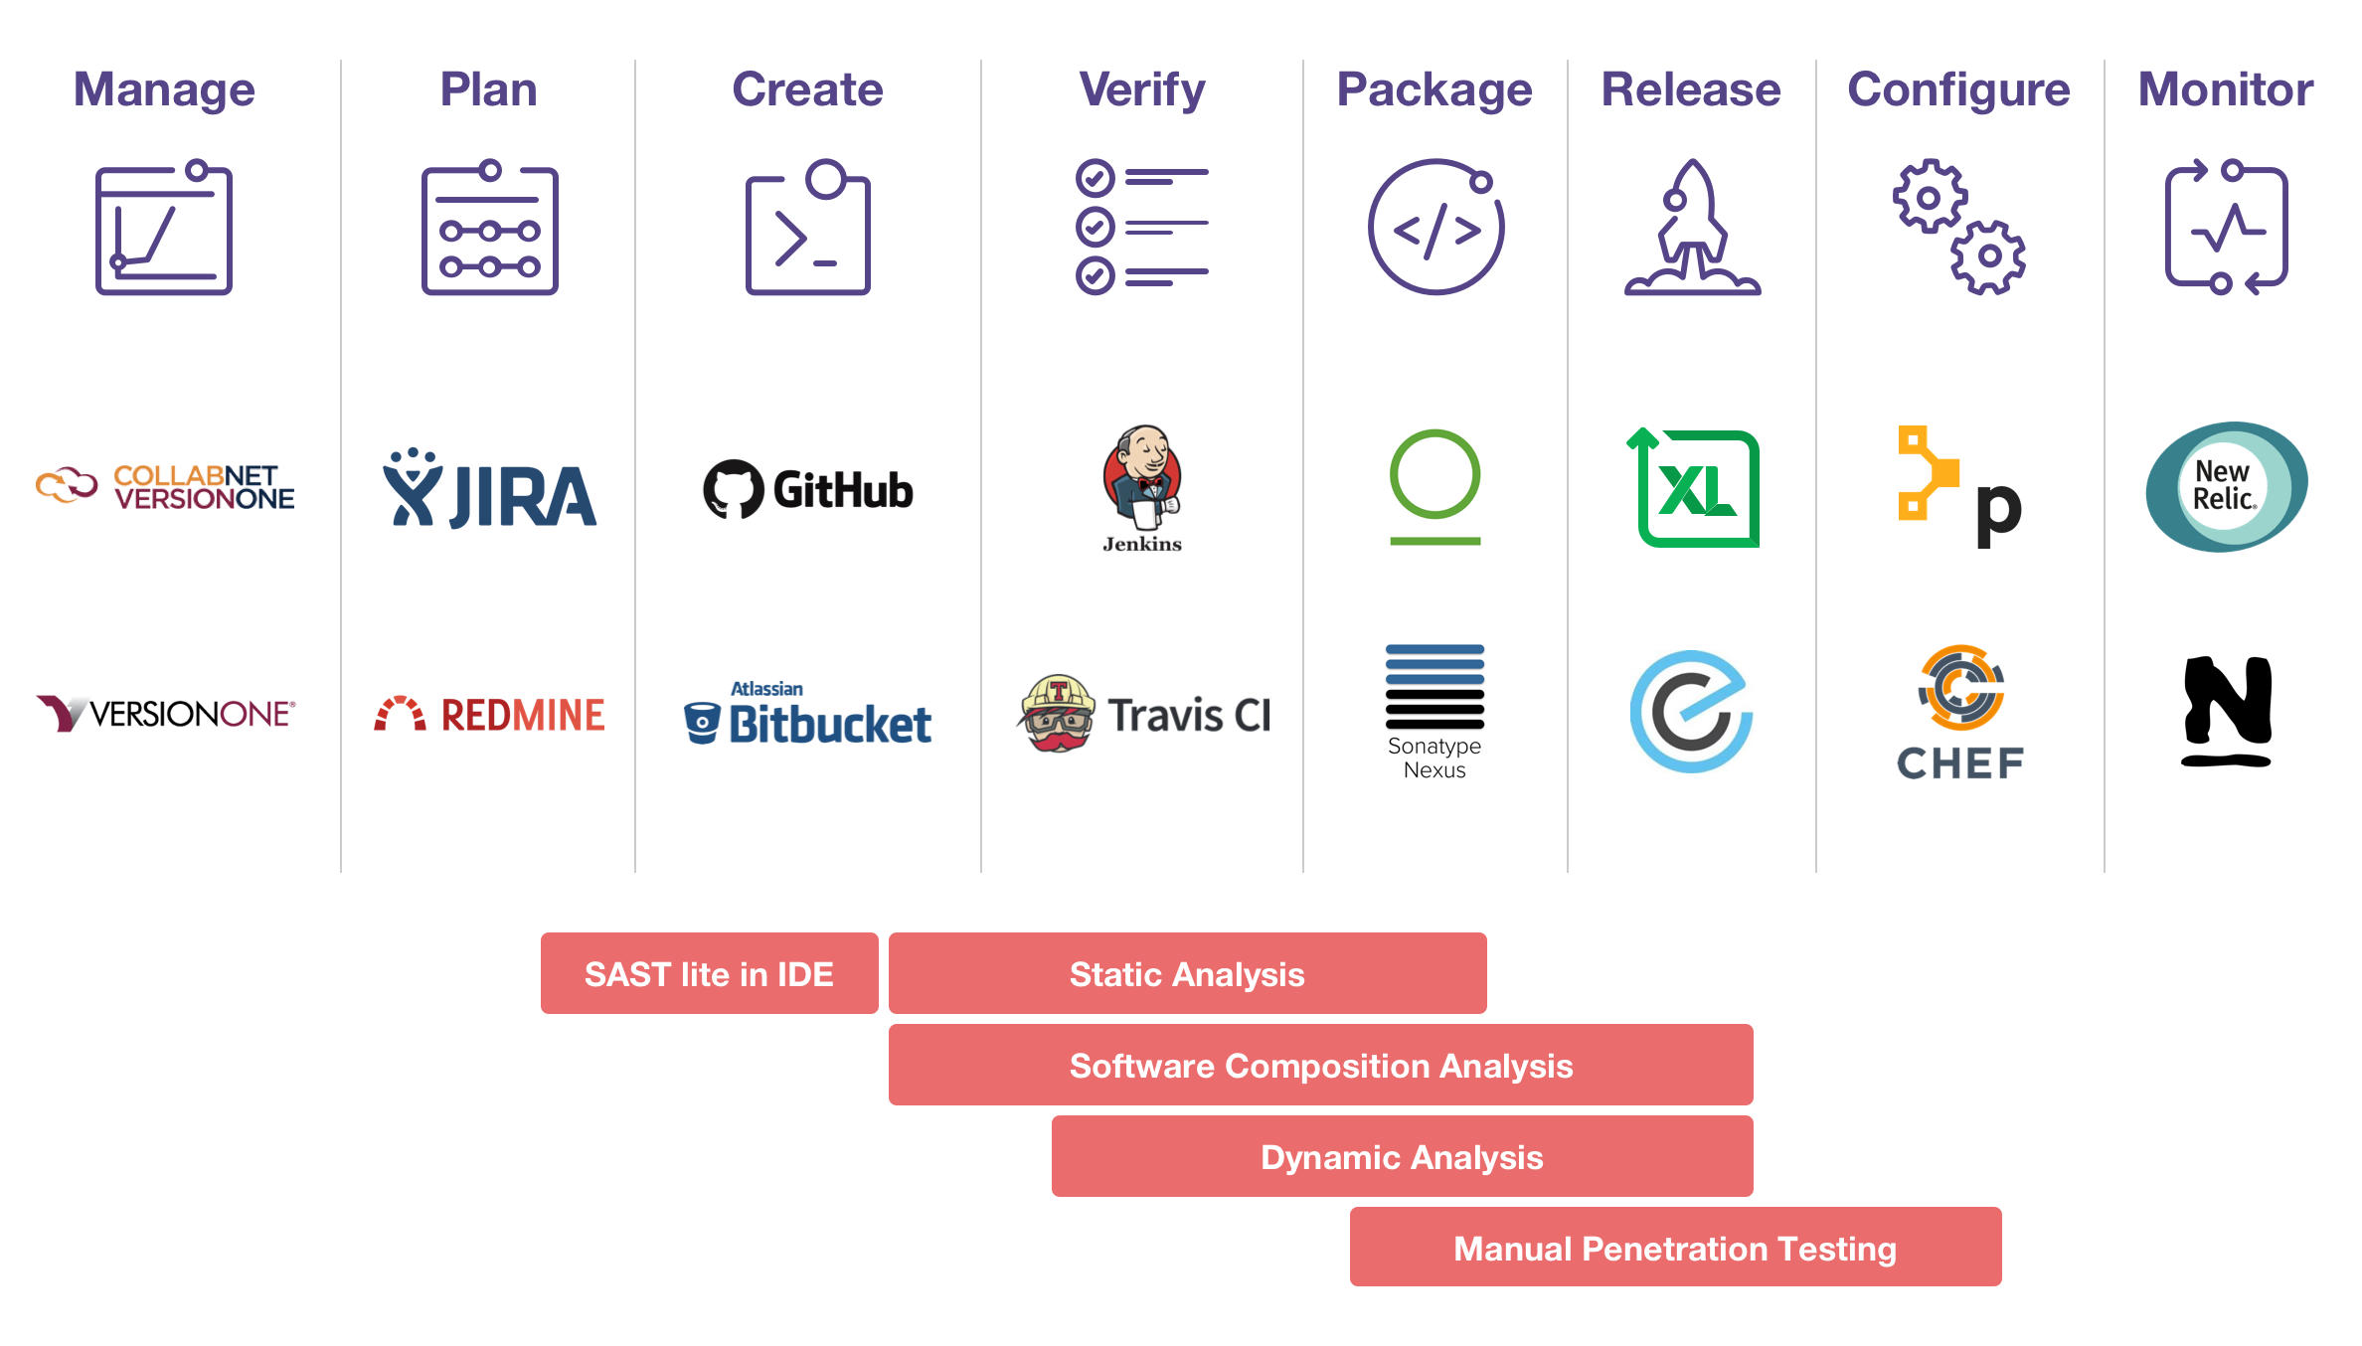
Problem: App Sec Silos Compound a Web of Integrations
Notes:
Context switching is a high-cost. This is paid for at every stage: between tools and between teams.
Where do we fit security into the software lifecycle?
Appsec toolchain is worse!
Individual vendors offer specific testing (Static, Dynamic, dependency, container/cloud, etc), each with its own license cost and integration requirements.
Fortify and Veracode offer dashboards to connect each - to pull all of their own test results together into one place!
<talk through slide: “the red boxes show where we add security to the process”>
SAST - using an insecure hashing algorithm
SAST lite - eclipse plugins or pre-commit hooks
SCA - outdated dependencies, blacklisted licenses
DAST - pulls HTML page and checks if your password forms have autocomplete enabled. Are secure headers in place to prevent forgeries?

Slide 16
Problem: Traditional App Sec creates a silo and friction
Notes:
1. User writes code

Slide 17
Problem: Traditional App Sec creates a silo and friction
Notes:
2. User commits code
Tests are ran

Slide 18
Problem: Traditional App Sec creates a silo and friction
Notes:
3. User opens Merge Request

Slide 19
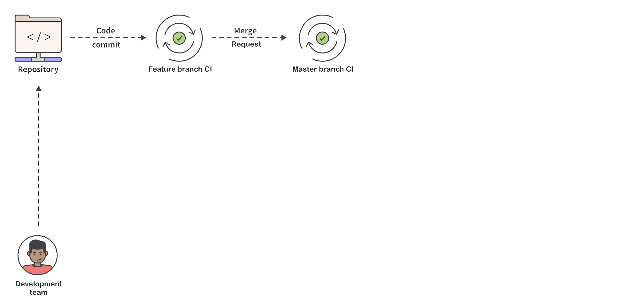
Problem: Traditional App Sec creates a silo and friction
Notes:
5. Merge Request is reviewed
6. Merge Request is merged
Reviewers check licenses and whitelist any new dependencies

Slide 20
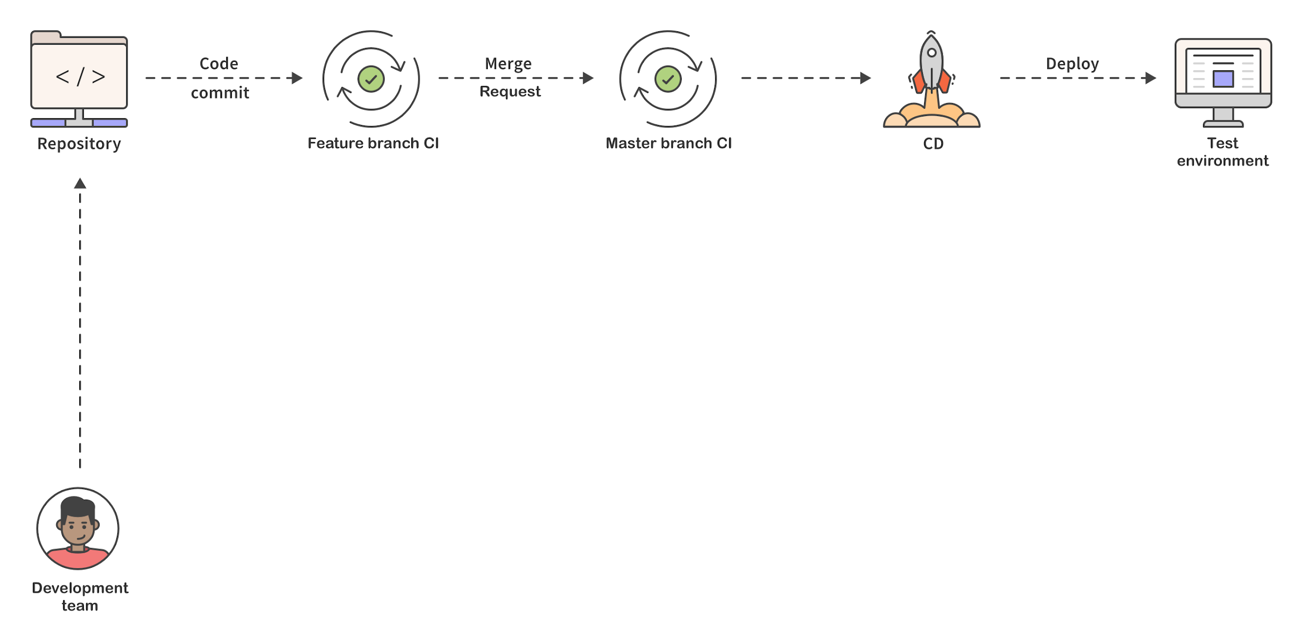
Problem: Traditional App Sec creates a silo and friction
Notes:
7. CD deployment to a test environment is triggered
This may often occur in batches, with other MRs to be tested

Slide 21
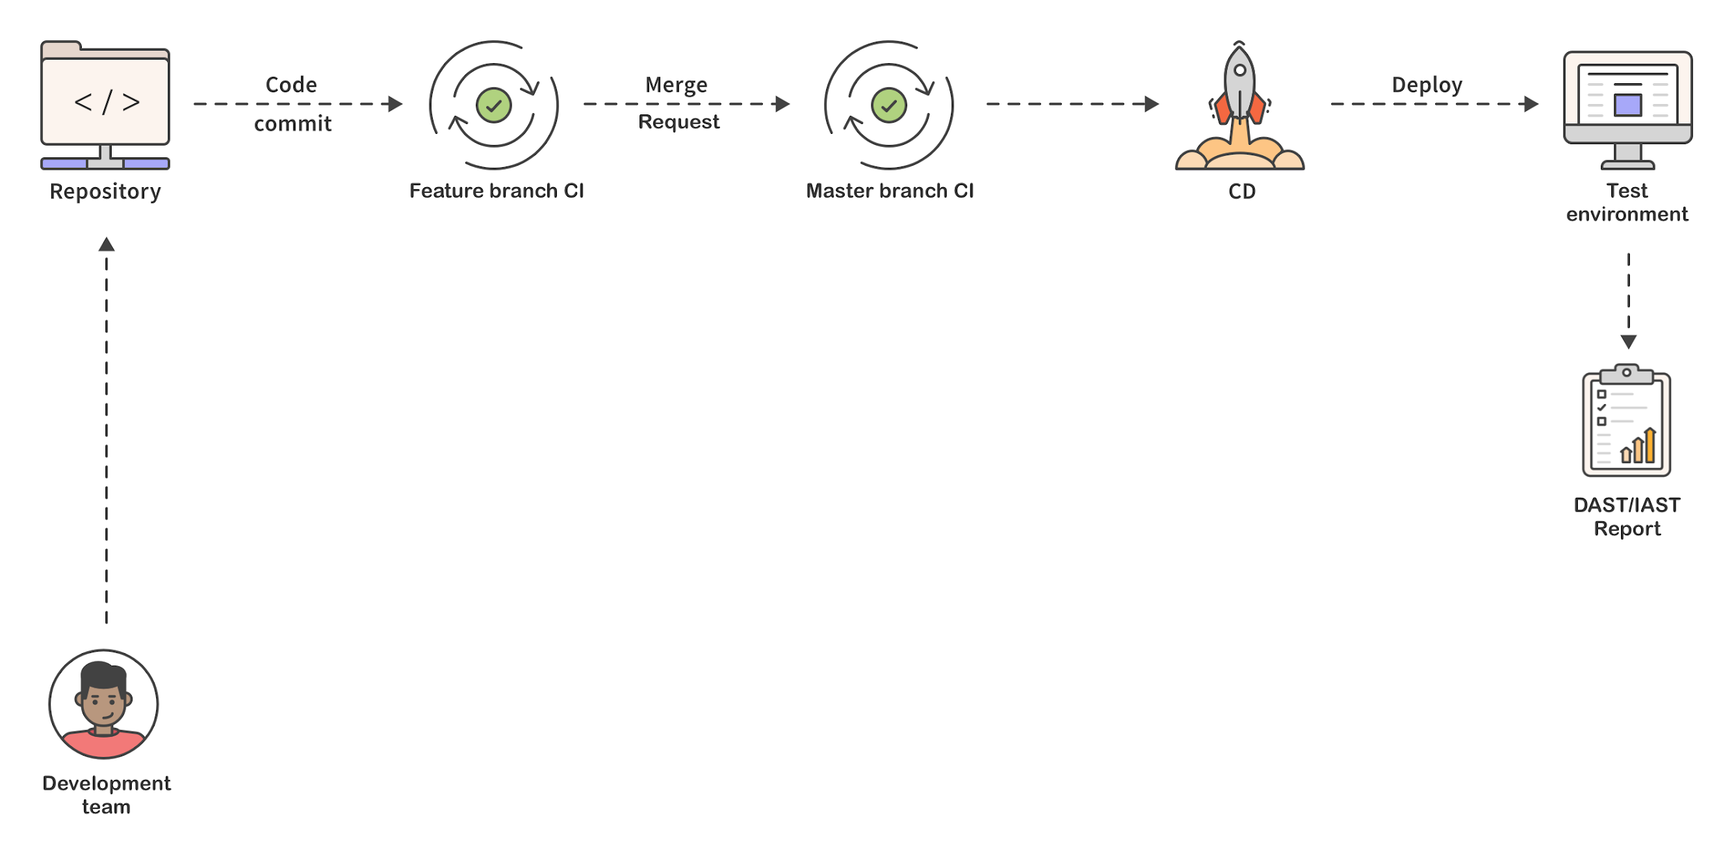
Problem: Traditional App Sec creates a silo and friction
Notes:
8. Dynamic scans run against test environment, generates security report

Slide 22
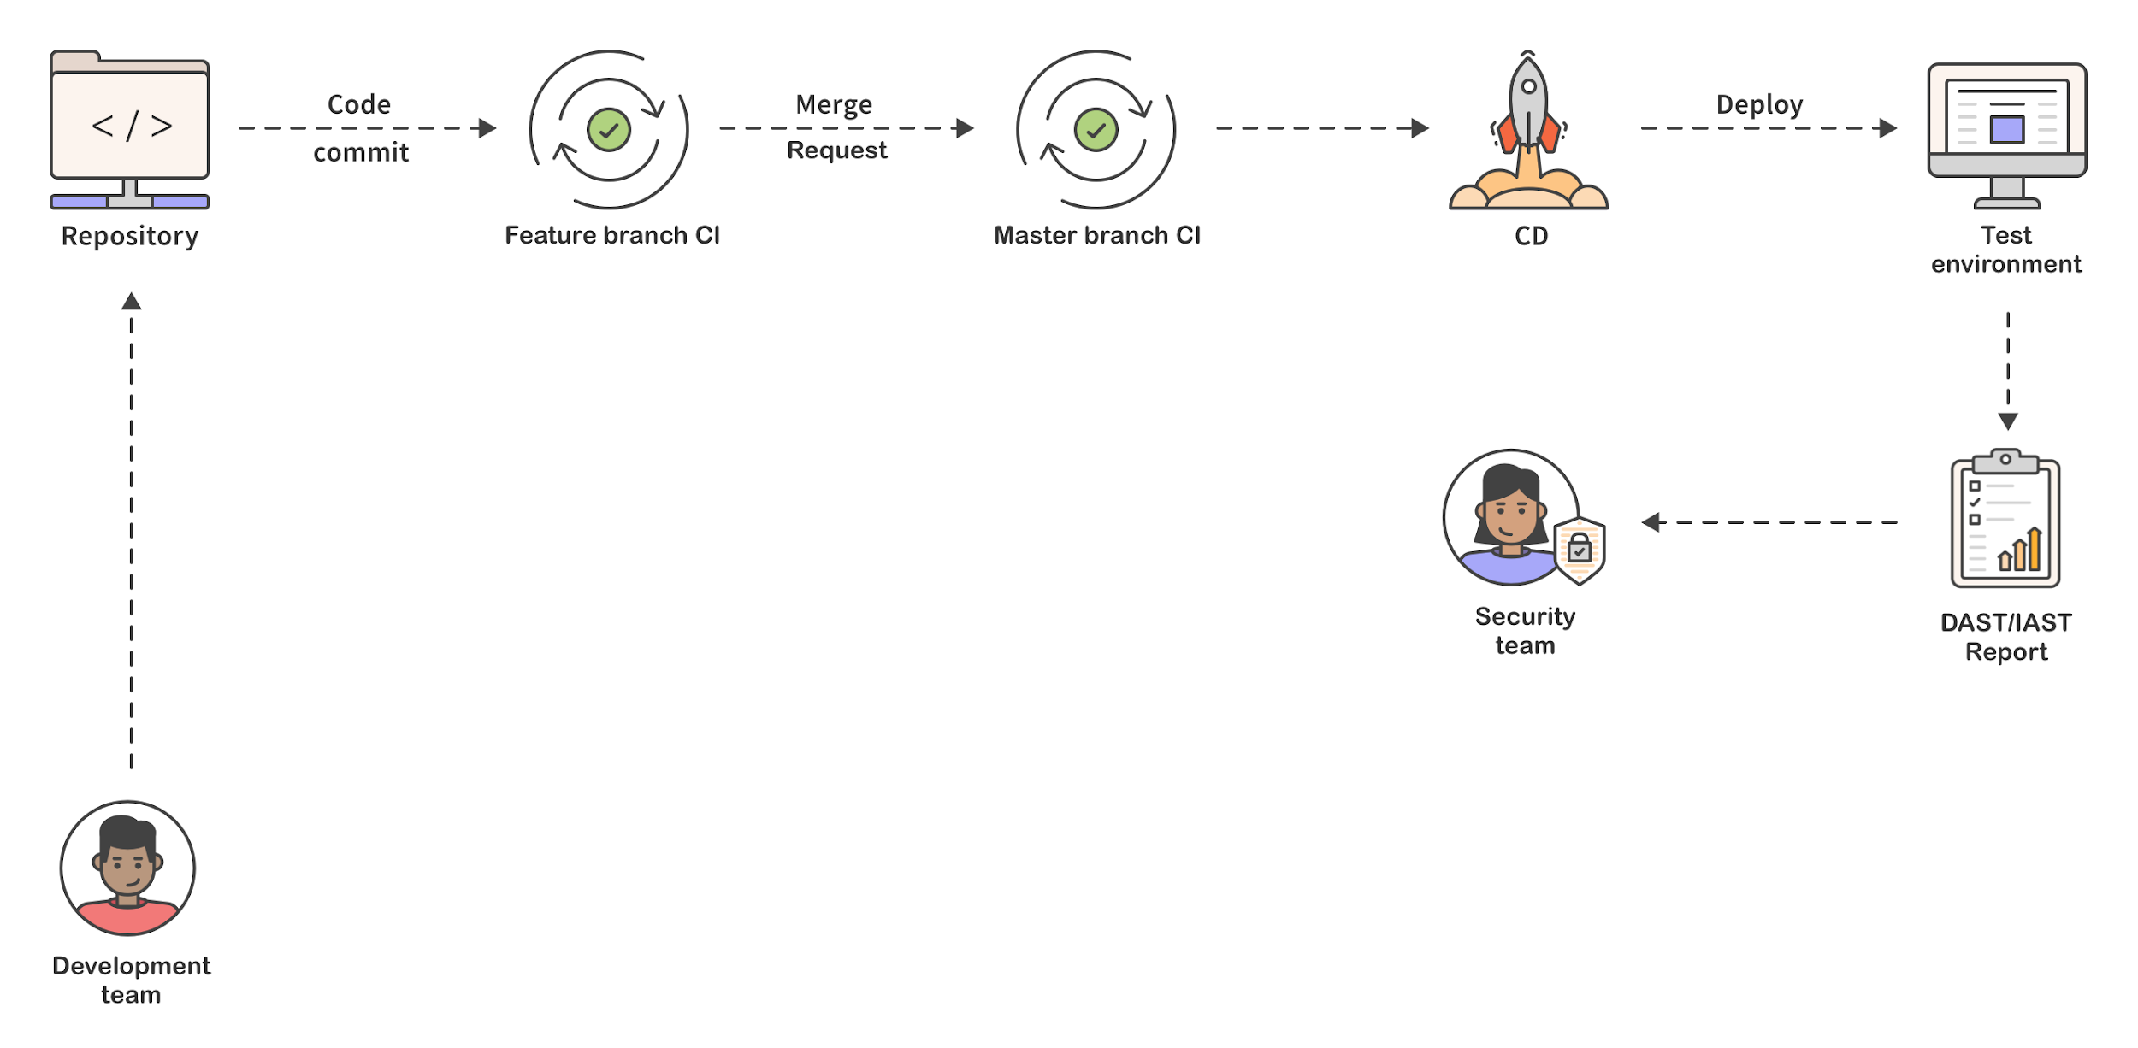
Problem: Traditional App Sec creates a silo and friction
Notes:
9. Security report is reviewed by security team

Slide 23
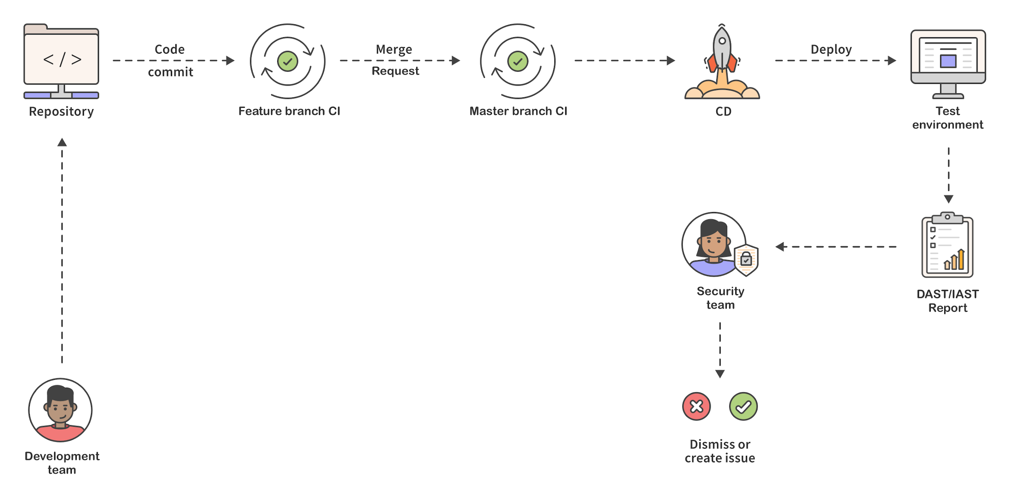
Problem: Traditional App Sec creates a silo and friction
Notes:
10. Security team dismisses false positives
11. Security makes issues for remaining items
“What code am I testing?”
“How bad is it?”
“Who/what is responsible for this?”
“Is this new?”

Slide 24
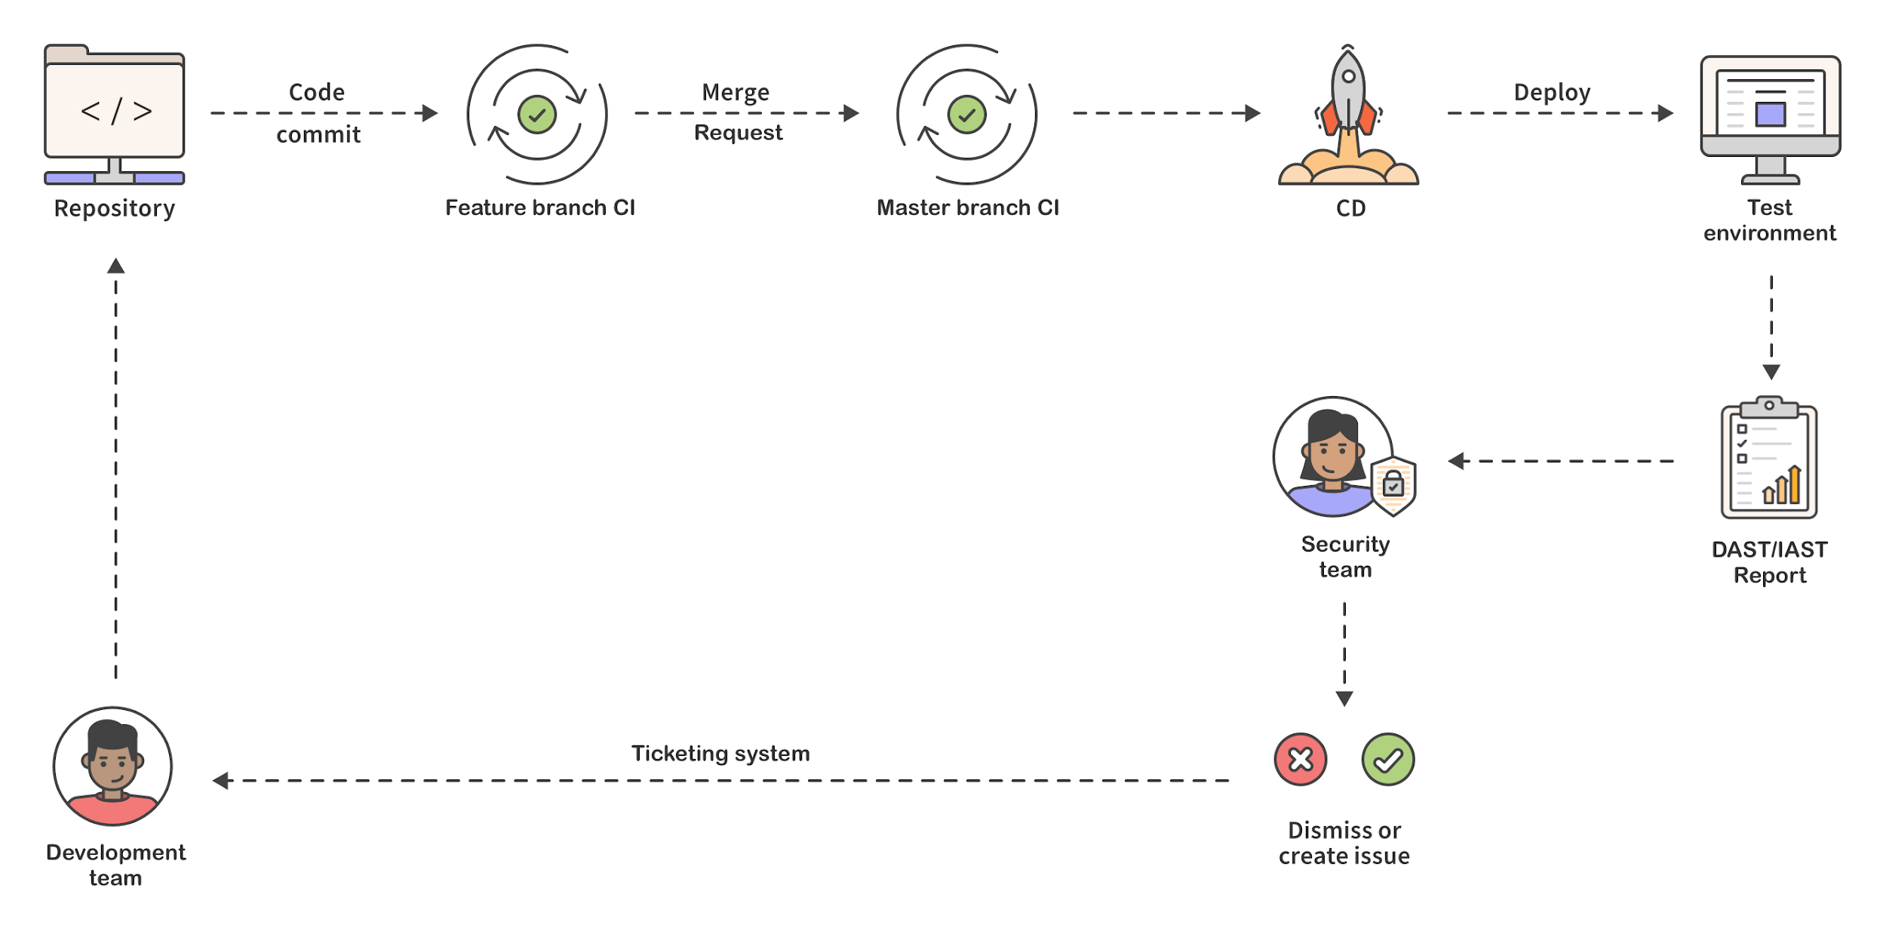
Problem: Traditional App Sec creates a silo and friction
Notes:
12. Security team passes issues back to developers and/or tries to find devs to address issues
13. Process restarts!
Not a perpetual loop of testing and rewriting. There's a jump-off point

Slide 25
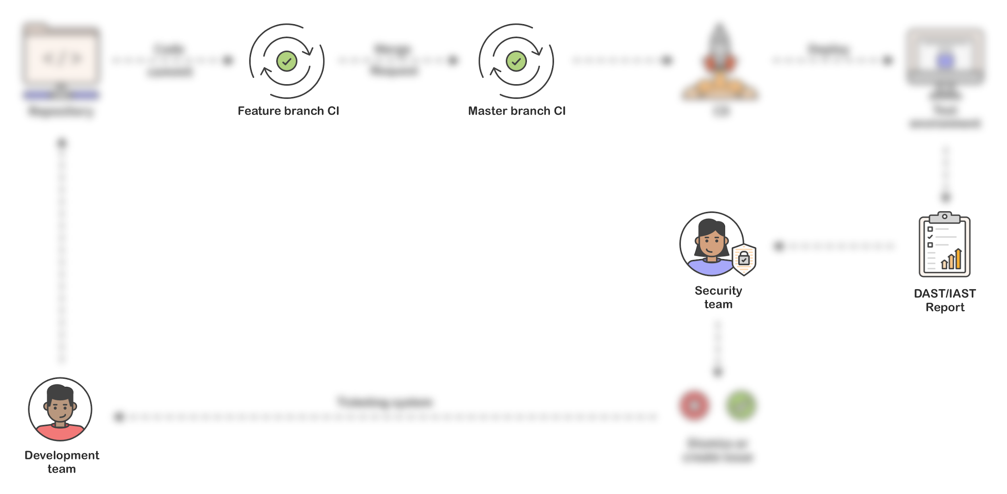
Problem: Traditional App Sec creates a silo and friction
Notes:
RECAP:
SAST via dev tools ONLY
Dependency Scanning during (merged) CI
License Management blacklisting/whitelisting during (merged) CI
DAST during deployment
Work already merged into the master branch &
in a dedicated test environment where QA tests would be performed along with DAST.
Traditionally DAST is done near end of SDLC because it requires a working application to test.
Because DAST is so late in the lifecycle, Interactive Application Security Testing (IAST) was born
Monitor during QA via instrumenting.
Intent: enable the developers, but a working test application is still required - and instrumentation
ISSUES:
1. Who is responsible for finding bugs?
2. "He said / she said" - results in fingerpointing between security team and dev team
3. resource intensive
4. Heavy context switching (both team members)
3. When is the application vulnerable?

Slide 26
Problem - Security and developer teams still fail to communicate
“Despite the enterprise benefits of adopting a DevOps culture, the majority of IT leaders polled believe communication between IT security and software development teams must improve greatly to achieve success.”
“Part of the challenge is believed to be — despite enthusiasm for DevOps, which has seen 81% of organisations already implement or currently work on projects — nearly half of respondents (46%) have only partially developed their DevOps strategy. IT leaders polled confirmed that enhancing IT security is more of a priority (46%) in DevOps than any other factor.”
Source: Devops Online survey results from Trend Micro 2019
https://www.devopsonline.co.uk/security-and-developer-teams-still-failing-to-communicate-says-report/
Notes:
Revisit Biggest concern: security and developer teams are still failing to communicate.
It's an issue of collaboration and keeps these roles distinct
“Not my job”
[We’re keeping] security out of developer’s hands
[Now] the security team focused on feature introduction, rather than exceptions.

Slide 27
Solving the bigger problem

Slide 28
Shifting further left
Workflows must target both teams (because shift left is a fundamental shift for companies)
Security must be empowering, not blocking
Dev must be engaged in security
Notes:
So how do we solve this? 3 takeaways:
1. Workflows must target both teams
2. Security must be empowering, not blocking
3. Devs must be invested in the security process
Increased collaboration and transparency
What does this look like?
Requires addressing vulnerabilities during the software creation process, not post-merge.

Slide 29
Shifting further left - Workflows must target both teams
Workflows must target both teams because shift left is a fundamental shift for companies; Proactive security:
Security vulnerabilities reported directly to accountable developers
Security teams do less tracking and triage and focus their skills.
Minimal context switching for embraceable workflow.
Ability to test every code change.
Notes:
“Proactive security” culture, amongst all teams
devs != sec, they require specific workflows

Slide 30
Shifting further left - Empowering security paradigm
Increase Awareness
Support decision makers, not replace them
Augment, dont block
Notes:
To get there we need to review our security paradigm.
What’s the goal of integrating security into workflows? EMPOWERMENT
Goal: awareness && supporting decision makers, not replacing
[Support] Need Interactive tools - improve signal-to-noise ratio
Provide DEV tools to secure their development
Provide SEC tools targeted at visibility, mitigation, and overview of the system.

Slide 31
Shifting further left - Developer engagement in security
Avoid warning fatigue
Shift both when scans occur and who performs them
The way we achieve this is by running our security scans before merge
Notes:
Adversarial: When we make security a blocker it often gets disabled or not considered at all.
Security must be a part of dev’s process
Warning fatigue:
Common, an engineer will begin to simply ignore an outdated package if they are reminded that it's outdated every time they open their terminal
Broken window theory
Golang - no warnings paradigm
HOW: Running all our scans during the MR itself. BEFORE MERGE

Slide 32
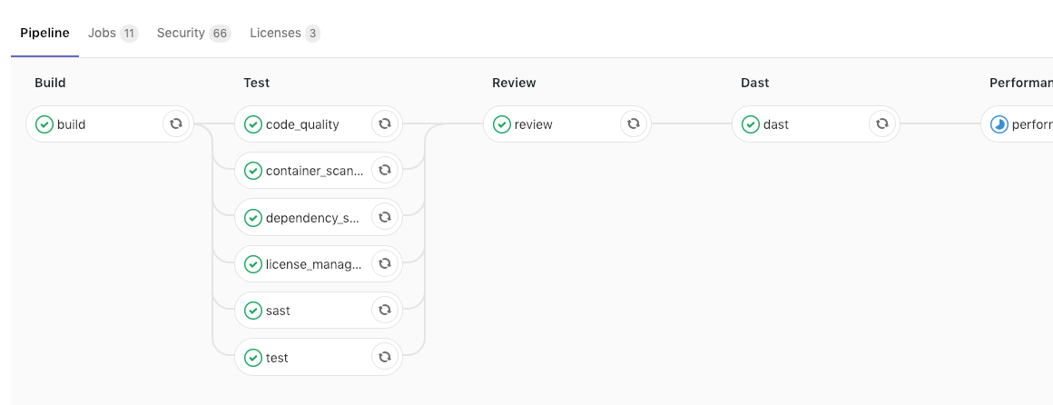
Pipeline including all security scans - before the code is merged
Notes:
“The way we achieve this is by running our security scans during the Merge Request itself.”
What does this mean, “before the code is merged”? It means
Dev sees the results immediately of every change
Vulnerabilities & license risk are shown within their pipeline as part of their natural flow.
They can see that everything passed - and if it did not, they would see that too, along with information to help them remediate the flaw.

Slide 33
Arming dev to resolve vulnerabilities and security to focus on exceptions
Notes:
What does this look like?
1. User writes code

Slide 34
Arming dev to resolve vulnerabilities and security to focus on exceptions
Notes:
2. User commits code

Slide 35
Arming dev to resolve vulnerabilities and security to focus on exceptions
Notes:
3. Tests are ran on commit

Slide 36
Arming dev to resolve vulnerabilities and security to focus on exceptions
Notes:
3. The user opens up the Merge Request while CI is running

Slide 37
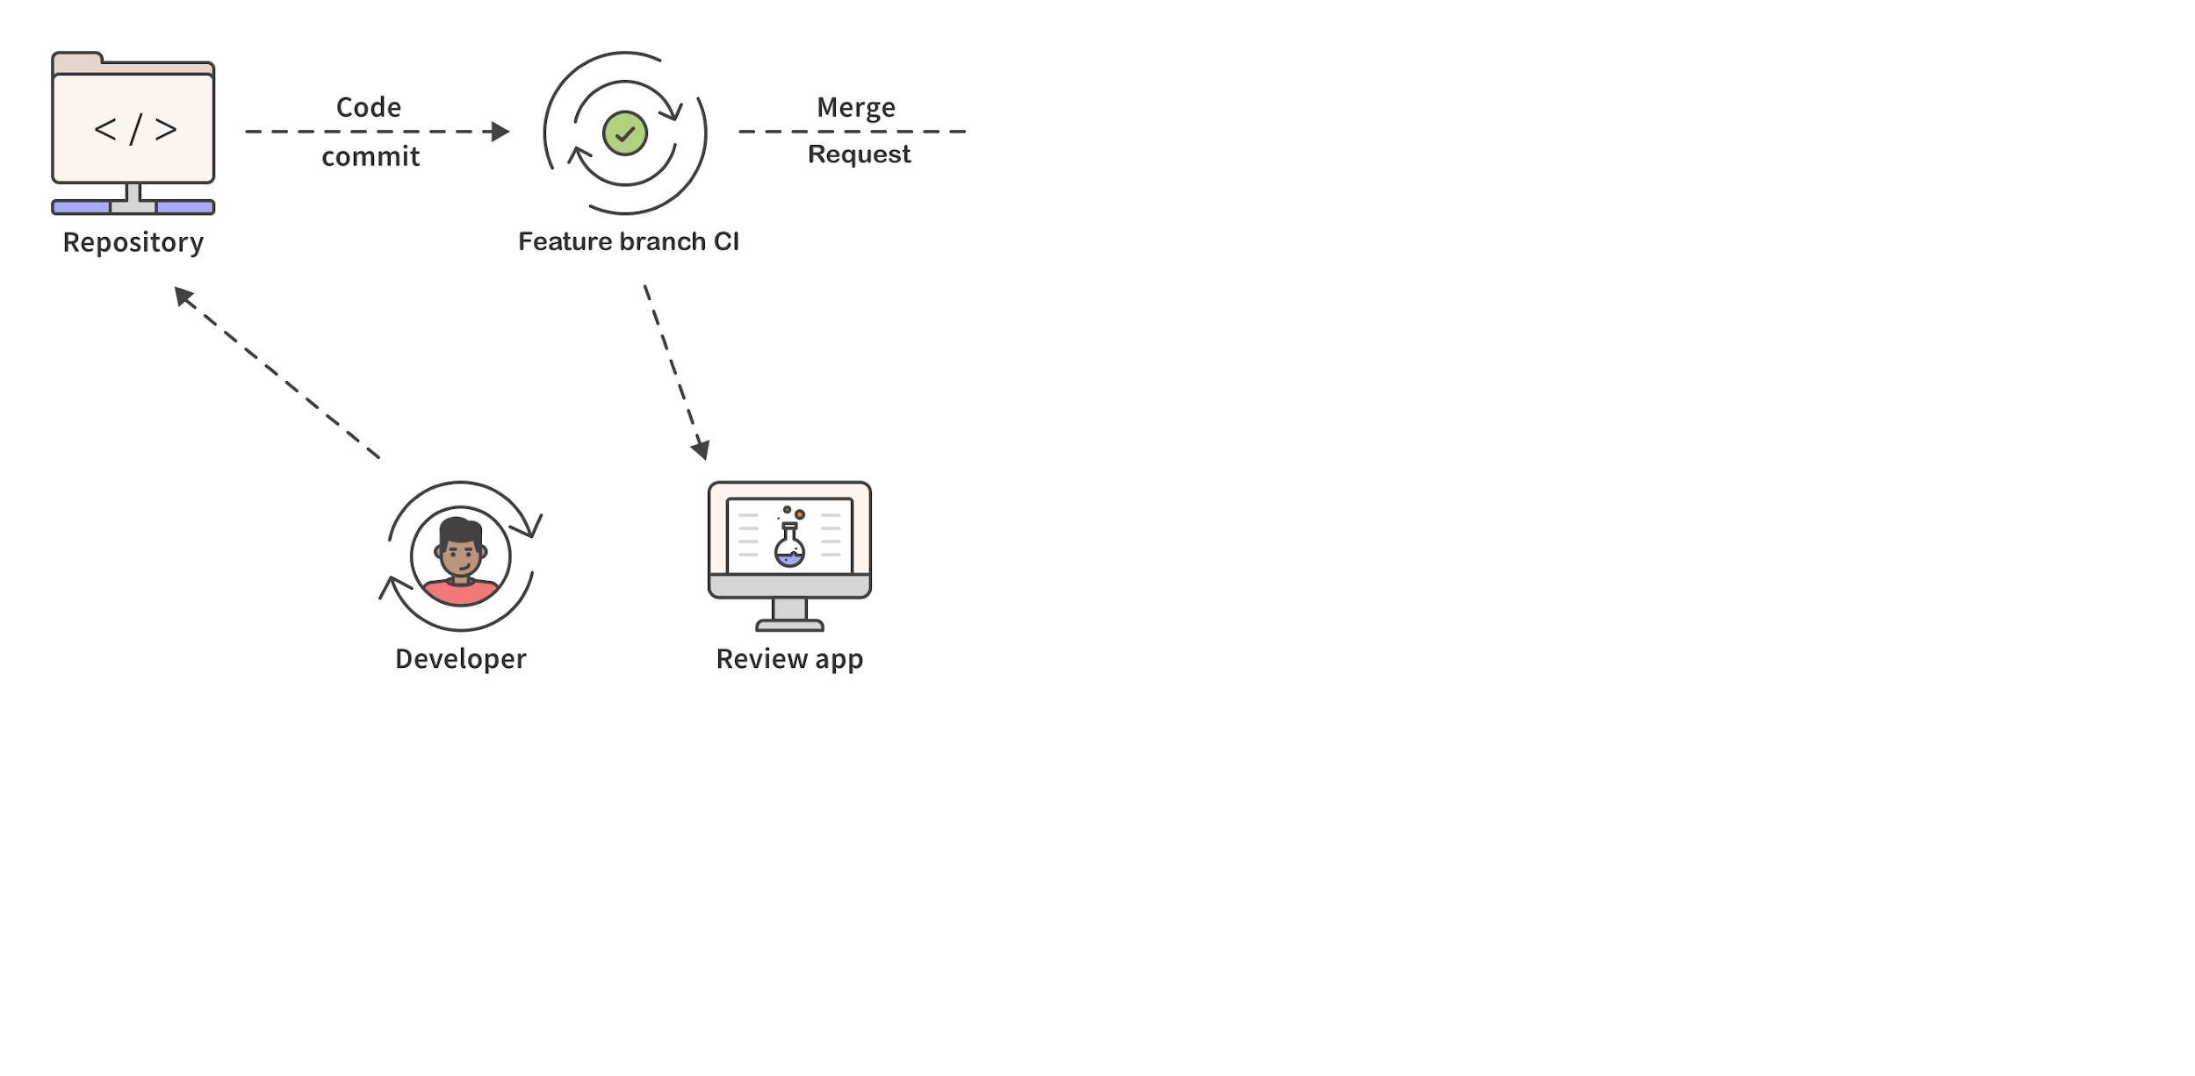
Arming dev to resolve vulnerabilities and security to focus on exceptions
Notes:
Meanwhile, an isolated environment is spun up through CI from the feature branch
In GitLab language, we call this item review app but there’s several terms for this isolated test app.

Slide 38
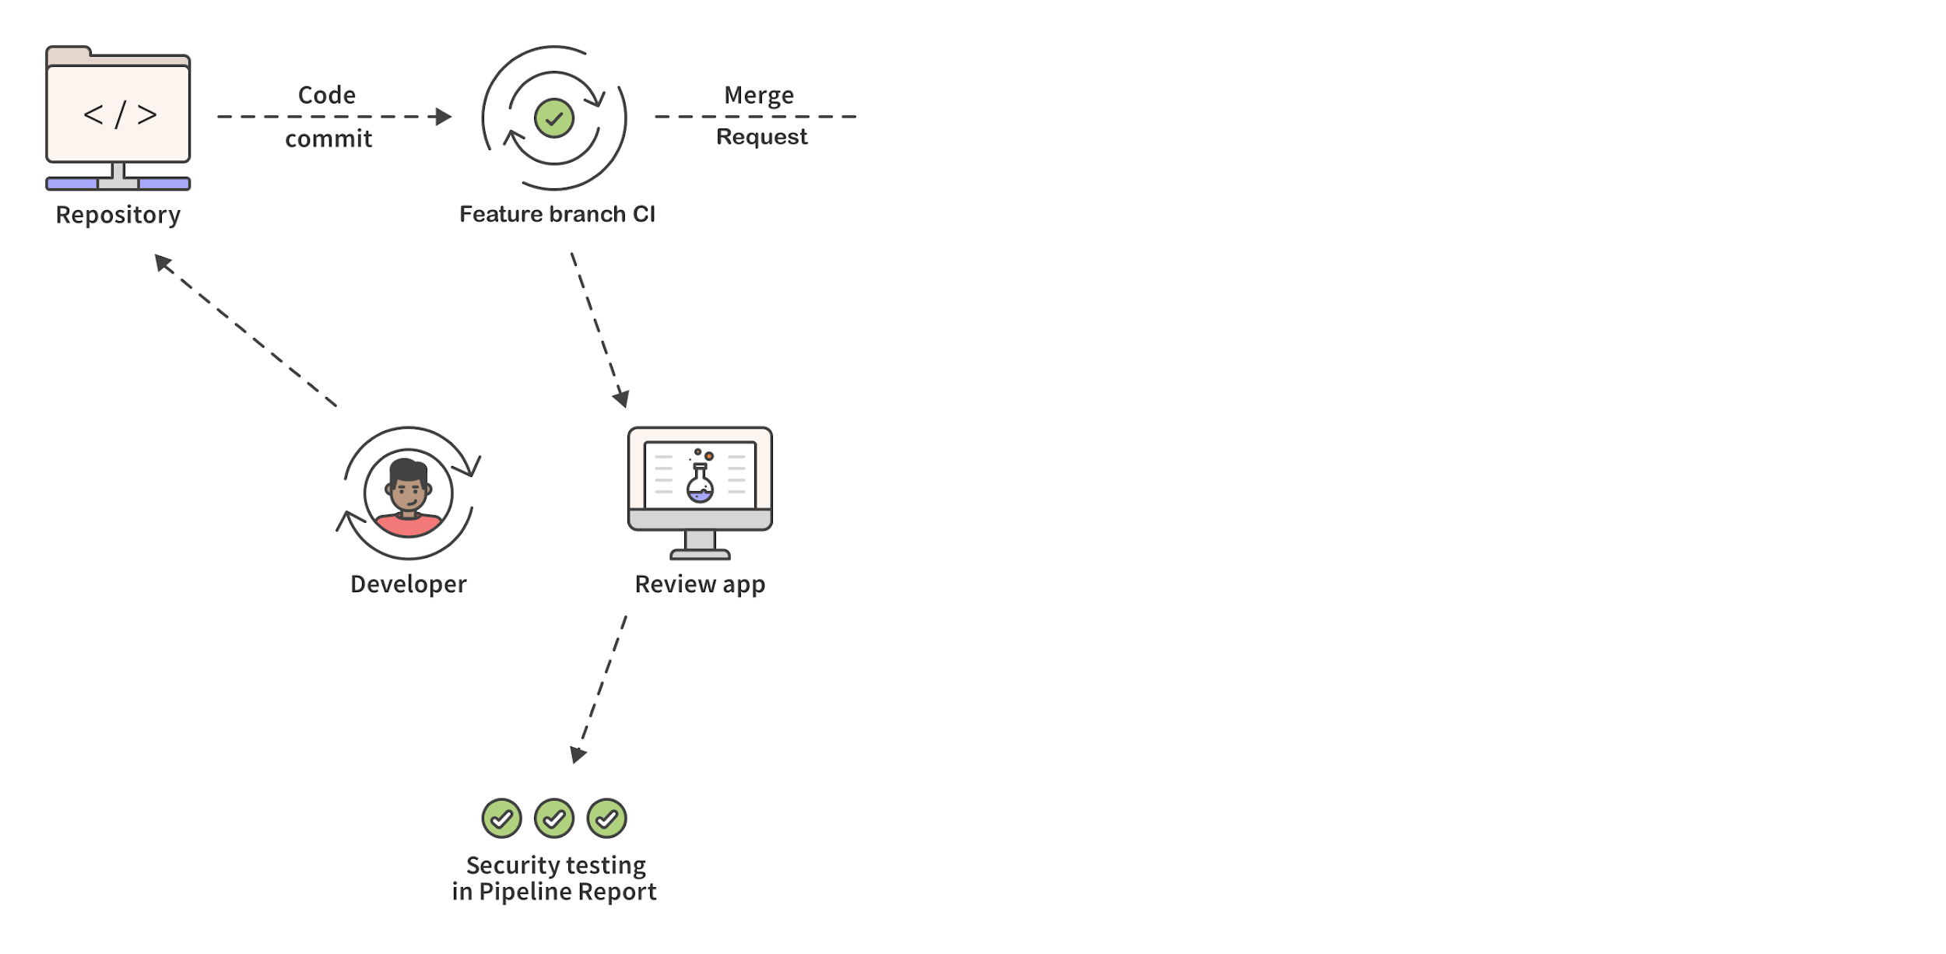
Arming dev to resolve vulnerabilities and security to focus on exceptions
Notes:
Security scans are ran against application

Slide 39
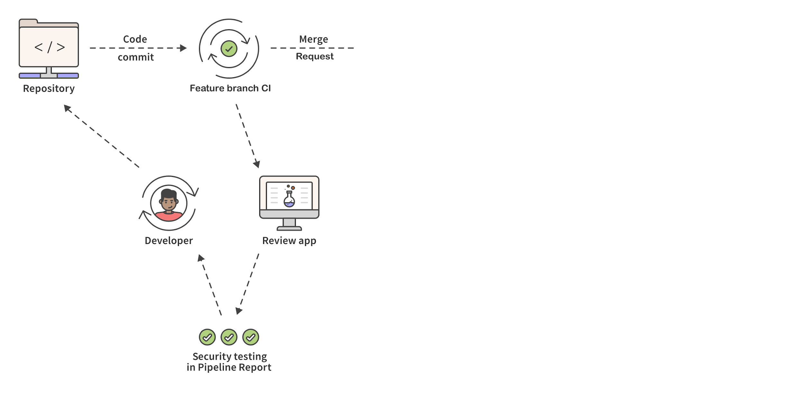
Arming dev to resolve vulnerabilities and security to focus on exceptions
Notes:
Scan results are reported back to the user WITHIN the context of the MR

Slide 40
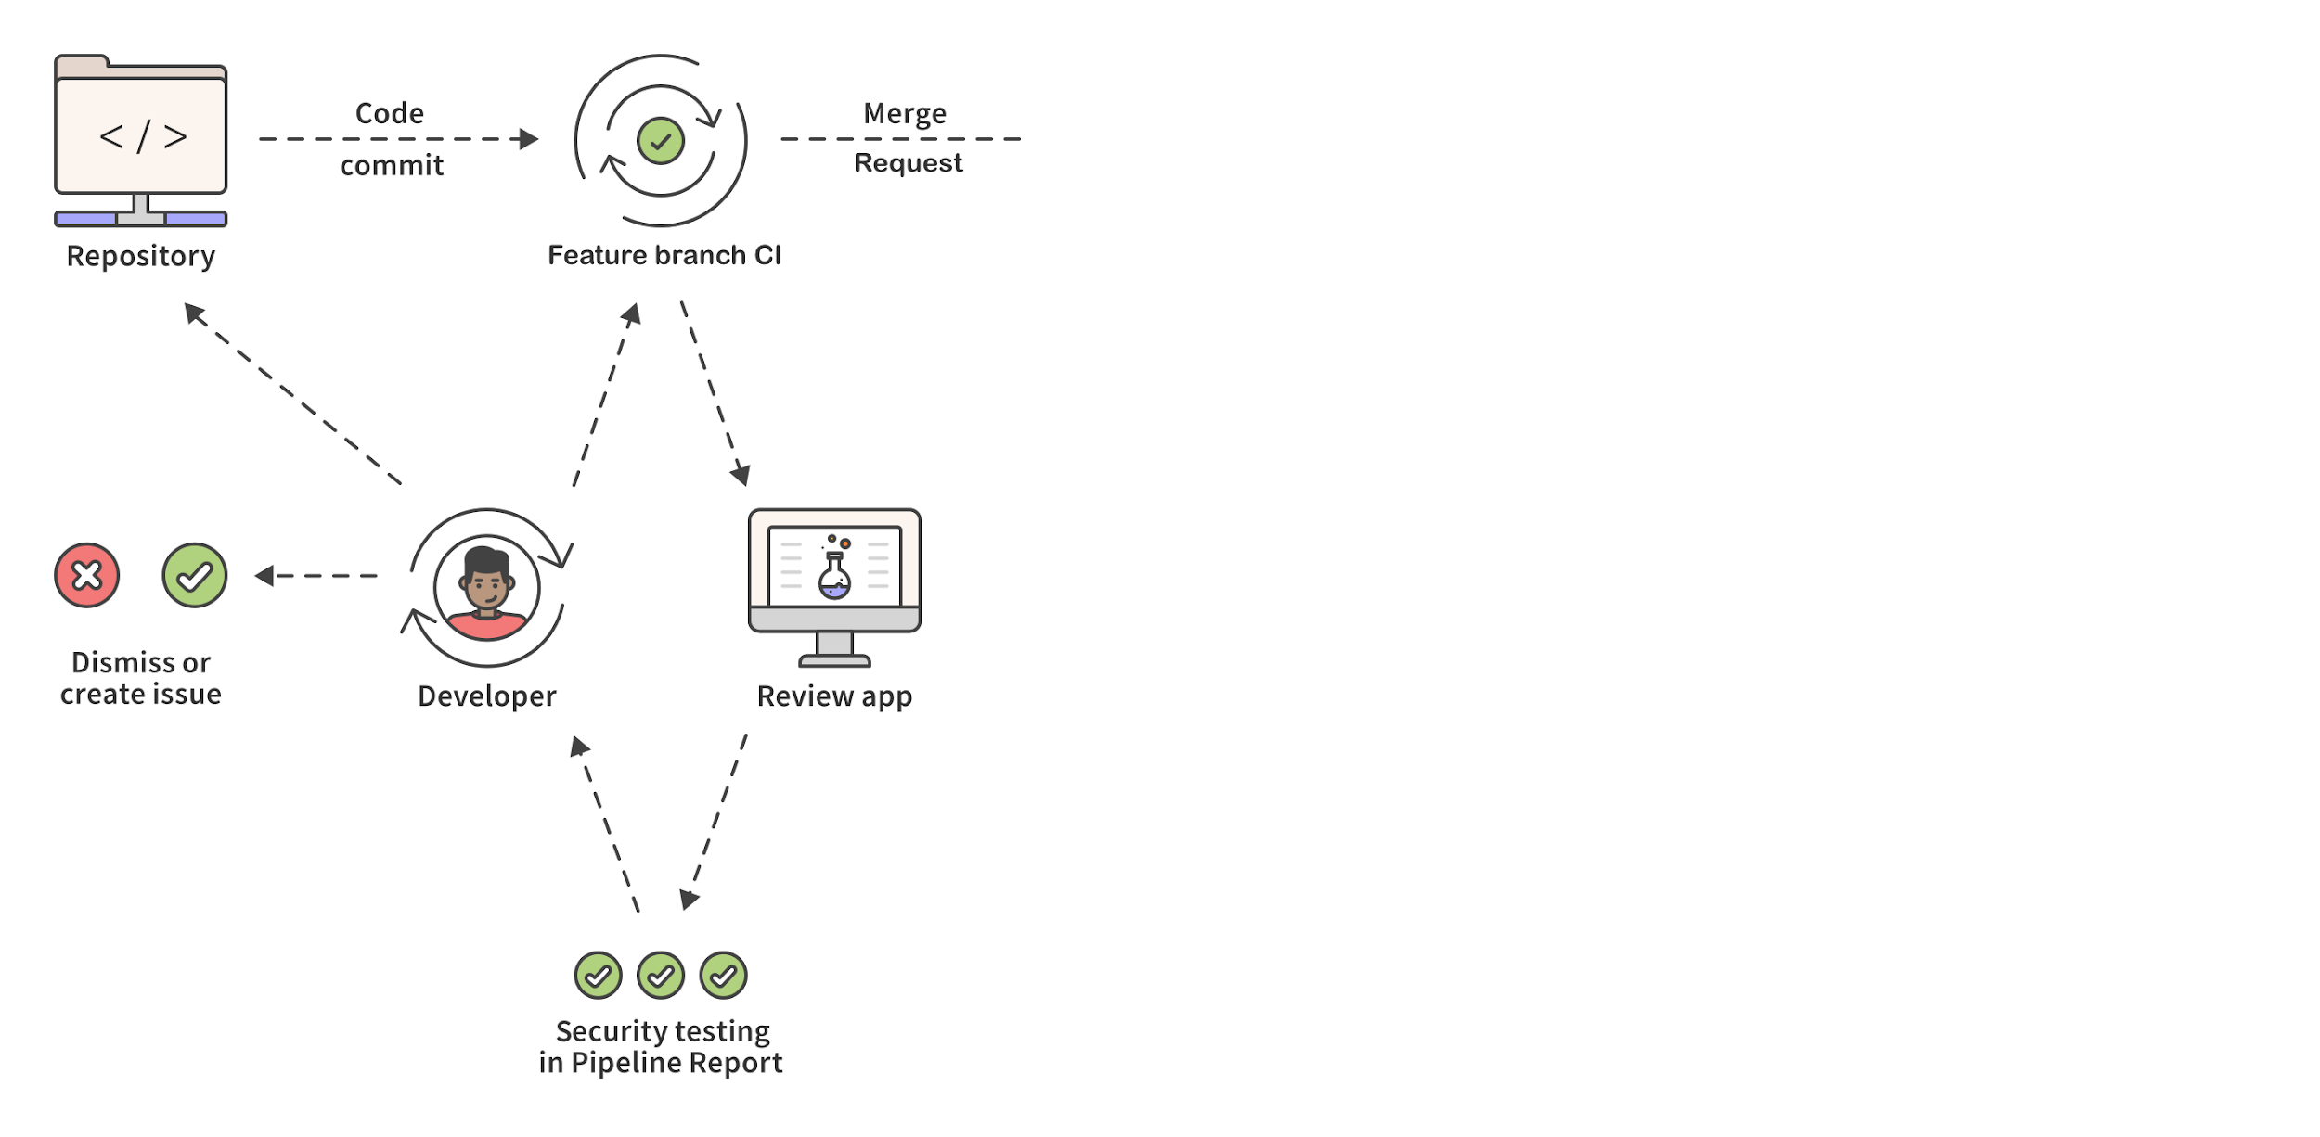
Arming dev to resolve vulnerabilities and security to focus on exceptions
Notes:
6. User updates code, fixes any security issues that appear
7. User creates issue to follow-up with any security issues that are unresolvable

Slide 41
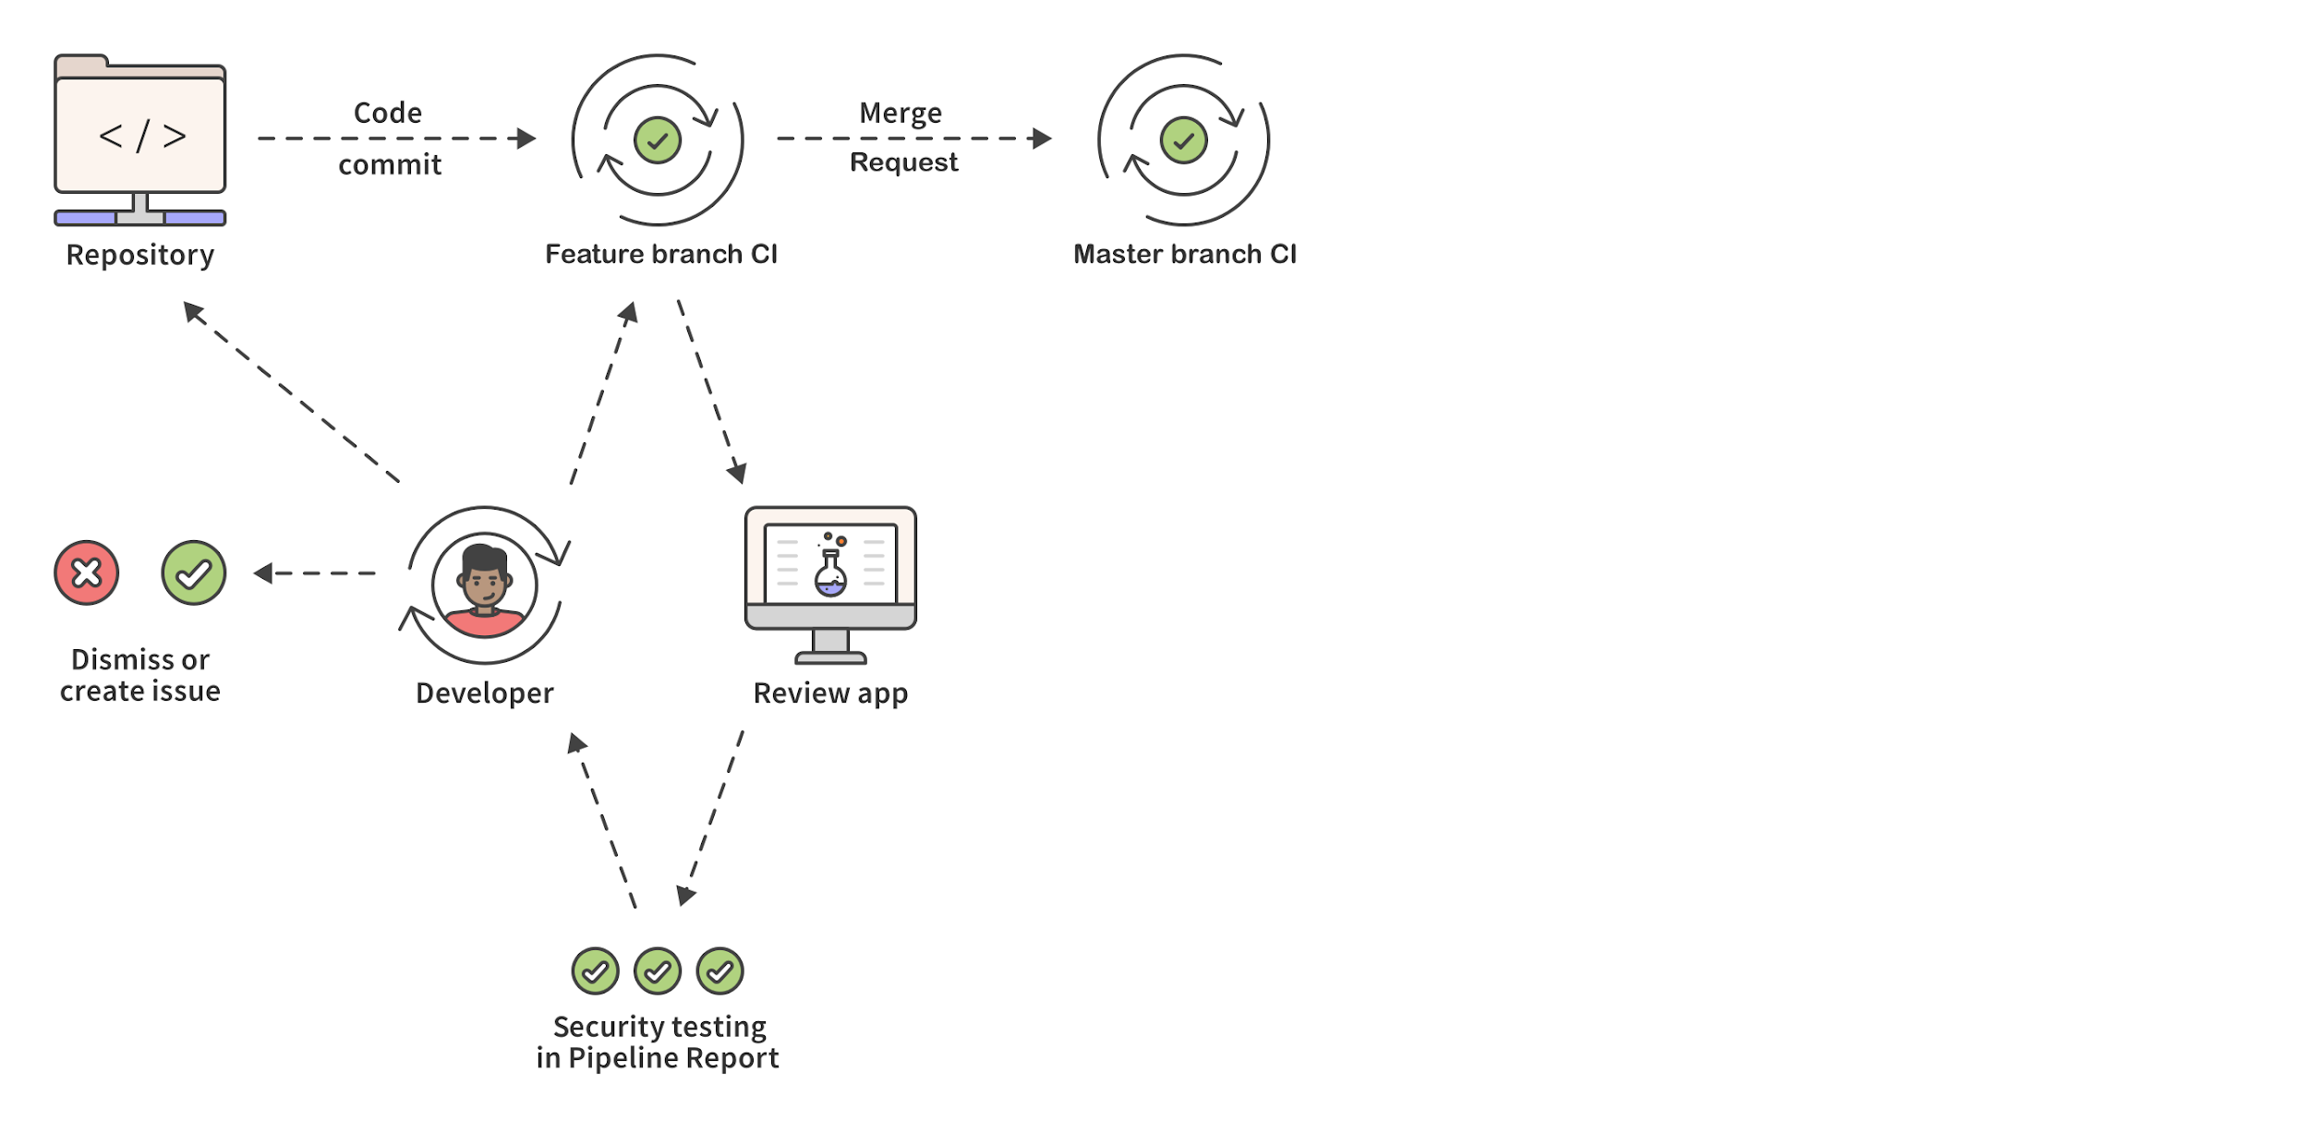
Arming dev to resolve vulnerabilities and security to focus on exceptions
Notes:
8. Merge Request is reviewed
9. Merge Request is merged, kicking off CI

Slide 42
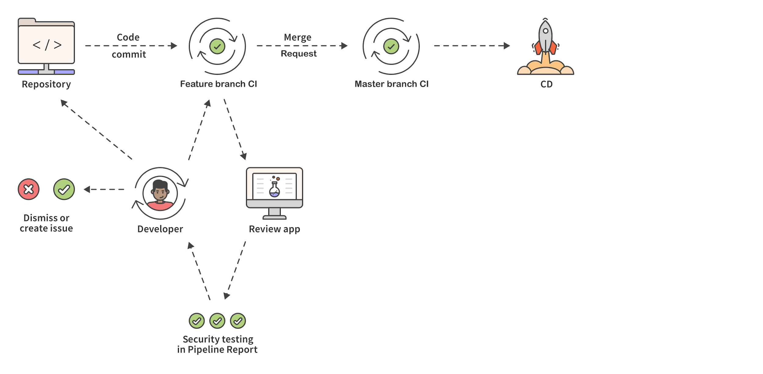
Arming dev to resolve vulnerabilities and security to focus on exceptions
Notes:
8. CD

Slide 43
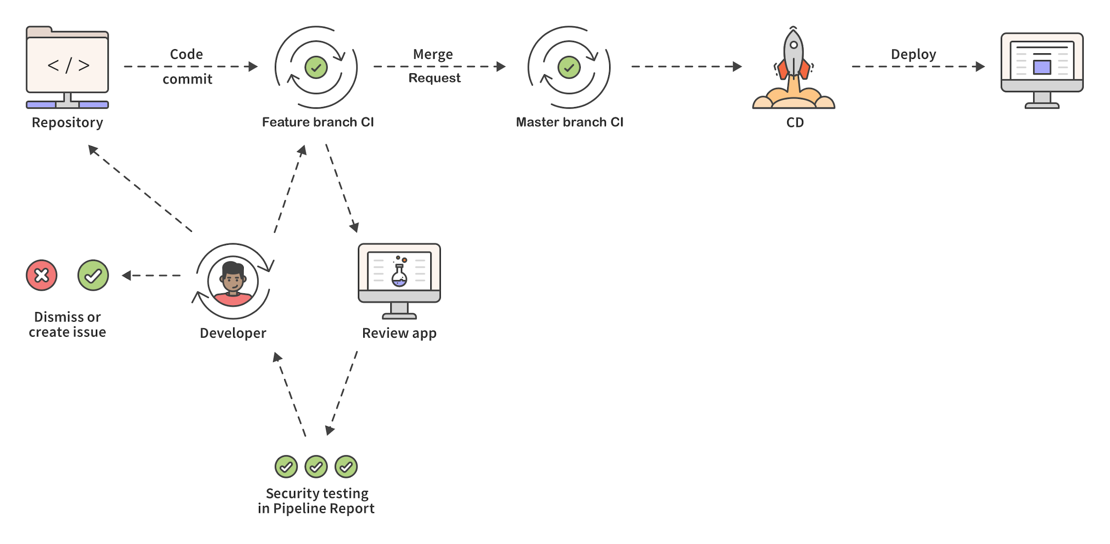
Arming dev to resolve vulnerabilities and security to focus on exceptions
Notes:
10. CD deployment to a pre-production environment is triggered, be it staging/QA/etc

Slide 44
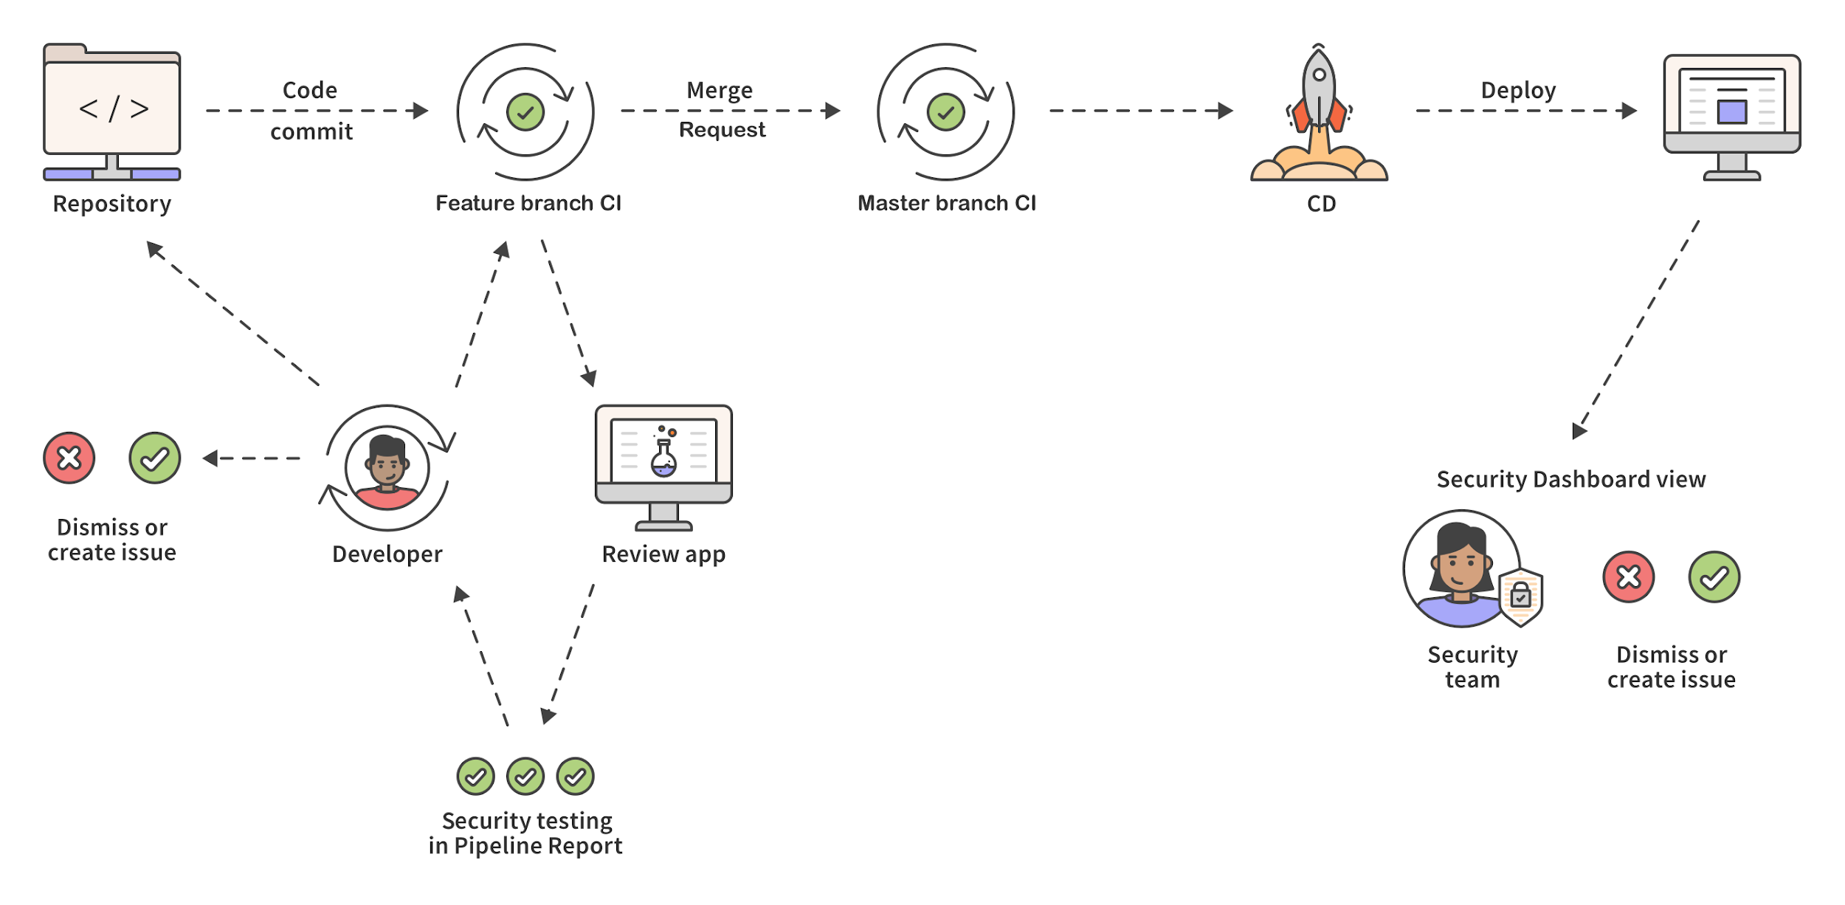
Arming dev to resolve vulnerabilities and security to focus on exceptions
Notes:
11. Security team focuses on a live environment that has been pre-scanned and keeps their eye on exceptions
WORKFLOW: Create/dismiss/triage active-threats.
Keep eyes outward not inward
Systemic understanding and concerns
So what are we looking at?
A review application is spun up at code commit - before the individual developer’s code is merged to master.
Centralizing scans
For devs, Sec failures are same as build failures

Slide 45
Arming dev to resolve vulnerabilities and security to focus on exceptions
Notes:
WHERE DO SCANS OCCUR?
SAST during CI
Dependency Scanning during CI
License Management blacklisting/whitelisting during CI
DAST during CI
ADVANTAGES:
- The developer can see and test the working application AND DAST can scan the review app in ISOLATION
- The developer can quickly iterate to resolve vulnerabilities reported in their pipeline report.
- The app sec team may never see these vulnerabilities because they can be identified and resolved before the code every leaves the developer’s desk.
Security is looking at the issue that individual developers are unable to resolve
Which equals fewer vulnerabilities that security has to deal with, and more remediation earlier

Slide 46
Advantage of this approach
Contextual
Notes:
Within CI/CD dev workflow - target accountable person
MR pipeline for dev team
Security dashboard for sec team (outward)

Slide 47
Advantage of this approach
Contextual
Congruent with DevOps processes
Notes:
Iterative within dev, tests every code change
Immediate cause/effect of code changes

Slide 48
Advantage of this approach
Contextual
Congruent with DevOps processes
Integrated with DevOps tools
Notes:
Create issues
Auto remediation
Development feedback != Production feedback

Slide 49
Advantage of this approach
Contextual
Congruent with DevOps processes
Integrated with DevOps tools
Efficient and automated
Notes:
Eliminate work wherever possible
Minimal context-switching
Security team spends less tracking/triaging and more value-added security help

Slide 50
Security as an Outcome not a Department
“Your most important security product won’t be a security product .”
CISO of VMWare
Notes:
Security must become everyone’s responsibility and must become a natural part of the development and operations workflows.
Iterative development doesn’t match a sequential security process.
Security must be as iterative as your software dev & deployment.
At RSA, the CISO of VMWare had this terrific point in his keynote.

Slide 51
Where can we go from here?
Notes:
One of the things I really value about working at GitLab is the transparent nature of the company.
Not only is our core product OSS but we build and discuss it in the open.
As such, we’re very focused on not only making the best product on the planet but getting results and finding that happiness.

Slide 52
Tightening the feedback loop
Security Approvals in Merge Requests: https://gitlab.com/gitlab-org/gitlab-ee/issues/9928
Show on dashboard when security tests are not ran: https://gitlab.com/gitlab-org/gitlab-ee/issues/7521
Forbid remote push if commit contains secrets: https://gitlab.com/gitlab-org/gitlab-ee/issues/8792
https://gitlab.com/groups/gitlab-org/-/epics/634
Notes:
Focused on ways to improve workflow
Connection b/w our primary stakeholders (dev and sec) stronger
Approvals -- providing a framework for Dev/Sec to work collaboratively at review
Dashboard - proactive mitigation
Forbid - shift even further left engaging security at “commit” stage
Each of these are active discussions

Slide 53
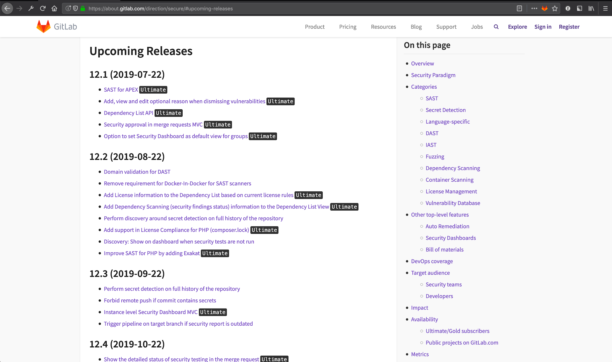
Roadmap
https://about.gitlab.com/direction/secure/#upcoming-releases
Notes:
We’re working actively on rethinking how to focus on these goals: more empowered teams, more collaboration, and more security awareness.
If you're more interested in what we're working on and have opinions, please feel free to check out our Product Vision page for "Secure" and see what we're discussing in our upcoming releases: https://about.gitlab.com/direction/secure/#upcoming-releases

Slide 54
Thank You
Lucas Charles
@theoretick - lcharles@gitlab.com
Slides: http://bit.ly/OSCONSecWorkflow
Whitepaper: http://bit.ly/OSCONSecWorkflowWhitepaper
Notes:
Thank you
I’m theoretick, my DMs are open.
Here are the slides if you’re interested, I’ll also tweet this out later
If you’d like to read more about this topic, we also have a whitepaper available
And feel free to reach out to me with any questions or concerns. Thanks!

Slide 55
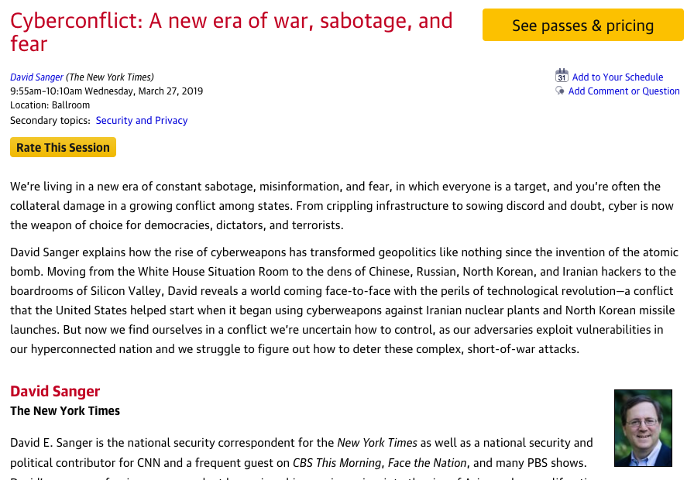
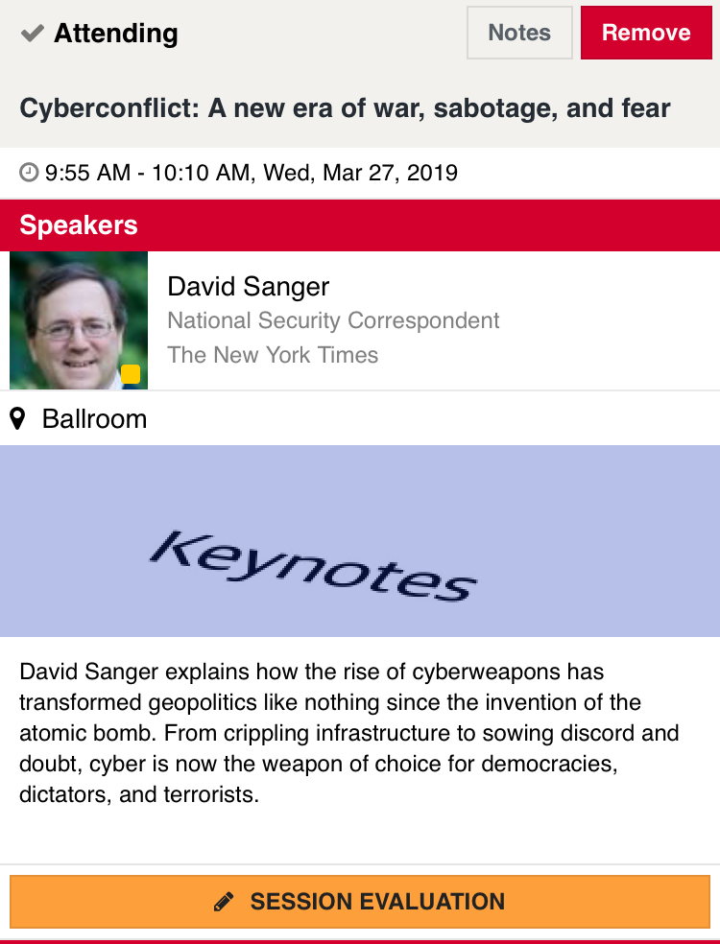
Rate today ’s session
Session page on conference website
O’Reilly Events App

